Slide 1
Module 2 : C# Basics

Slide 2
Agenda
History and Evolution of C#
C# Strengths
Object Oriented Programming in C#
C# Programming Basics(DataTypes,Variables,Expressions,Operators,TypeCasting)
String class
Loops and Conditional Statements
Arrays, Struts
Methods(Optional, Named parameters)
Interfaces
Properties, Indexes
Exception Handling
Static Types(Classes, Methods, Properties)
Delegates and Events
Using Statements
Useful links

Slide 3
History
In January 1999, Anders Hejlsberg formed a team to build a new language at the time called Cool, which stood for "C-like Object Oriented Language".
By the time the .NET project was publicly announced at the July 2000 Professional Developers Conference, the language had been renamed C#, and the class libraries and ASP.NET runtime had been ported to C#.
http://aboutcsharpprogramming.blogspot.com/2012/09/history-of-c-programming.html

Slide 4
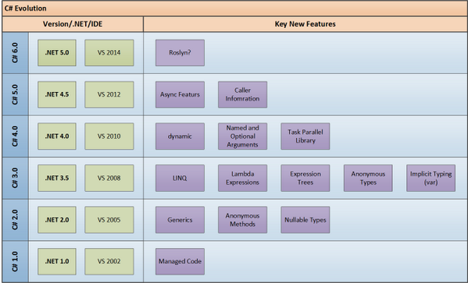

Slide 5
Why C# → Strength
First object-oriented language built
Builds on COM+ experience(Components)
Native support for
Namespaces
Versioning
Attribute-driven development
Power of C with ease of Visual Basic
Minimal learning curve for everybody
Much cleaner and simpler than C++
More structured than Visual Basic

Slide 6
Why C# → Strength
Pure object orientation without compromising efficiency (Value types & References)
Pseudo- compiled, Native execution
Cross language integration with Visual C++, Visual Basic, and other .NET enabled languages
Explicit support for unsafe code
Attributes - a very unique idea
Boxing/ Unboxing
Explicit interface member implementation
Can be embedded in ASP
Support for P/Invoke, COM

Slide 7
Object-Oriented Characteristics
All managed languages in the .NET Framework, such as Visual Basic and C#, provide full support for below object-oriented programming concepts.
Abstraction
Encapsulation
Inheritance
Polymorphism

Slide 8
Abstraction
Abstraction Works from the Specific to the General.
Grouping Elements Makes It Easier to Work with Complex Data Types.
Abstraction Is Supported Through Classes.

Slide 9
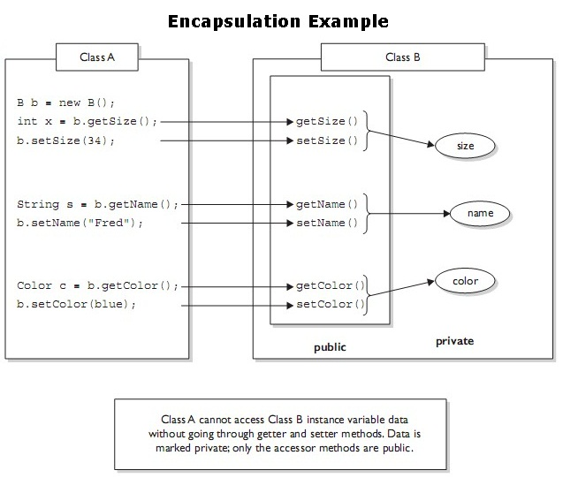
Encapsulation
Encapsulation means that a group of related properties, methods, and other members are treated as a single unit or object.
Encapsulation Is the Process of Hiding Internal Details of a Class
Encapsulation Keywords
public
protected
internal
private
Type-Level Accessibility
Nested Classes

Slide 10
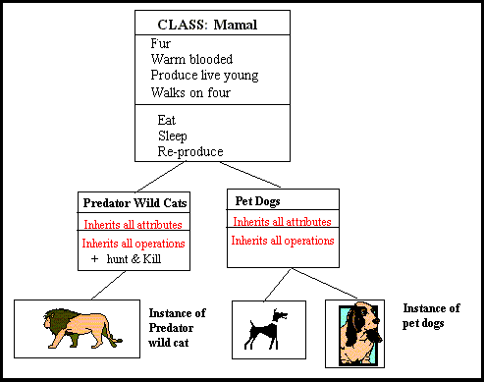
Inheritance
Inheritance describes the ability to create new classes based on an existing class.
Inheritance Is the Reuse of Class Members in Other Classes.
The Common Type System Only Supports Single Inheritance for Classes.
Member Hiding
Redefine the same method in the derived class.
Use the new keyword.
Abstract Members which are going to be defined in derived class.
Sealed Classes which can’t be inherited.

Slide 11
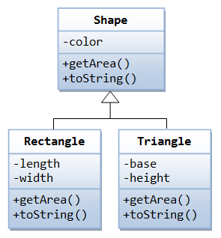
Polymorphism
Polymorphism means that you can have multiple classes that can be used interchangeably, even though each class implements the same properties or methods in different ways.
Polymorphism Allows a Reference Variable to Call the Correct Method
Virtual Methods Enable Polymorphism in the Common Type System
Use the virtual keyword in the base class
Use the override keyword in the derived class
Sealed Methods

Slide 12
C# Language Basics →
C# was developed at Microsoft. It is an object-oriented programming language and provides excellent features such as strong type checking, array bounds checking and automatic garbage collection
C# Language Basics
Data Types
Program Structure
Variables, Constants, Operators
Flow Control in C#

Slide 13
Getting Started: Hello World
using System;
class Hello {
static void Main( ) {
Console.WriteLine("Hello world");
Console.ReadLine(); // Hit enter to finish
}
}
Notes:
The Hello World application is very simple in C#. Some key points:
In C# there are no global methods. Everything belongs to a class.
A method named Main is the entry point for a C# application. Note that Main is spelled with a capital “M”, which is different than C and C++. The reason is that for consistency, all method names start with a capital letter in the .NET Framework
The line using System; means that we’ll be accessing members of the System namespace. In a very rough comparison, a namespace could be translated to a Unit in Turbo Pascal/Delphi or a .LIB file in C/C++. So in the Hello World example, the class Console, which contains the method WriteLine belongs to the System namespace. We could avoid the “using” statement by writing the complete path of the method: System.Console.WriteLine(“Hello World”);

Slide 14
Data Types Overview
A C# program is a collection of types
Classes, structs, enums, interfaces, delegates
C# provides a set of predefined types
E.g. int, byte, char, string, object, …
You can create your own types
All data and code is defined within a type
No global variables, no global functions
Types can be instantiated…
…and then used: call methods, get and set properties, etc.
There are two categories of types: value and reference
Types are arranged in a hierarchy
Notes:
In most other purely object-oriented languages one would say that a program is a collection of classes.
Not all types have all capabilities; e.g. enums are fairly constrained.

Slide 15
Data Types Overview - Cntd
Types contain:
Data members
Fields, constants, arrays
Events
Function members
Methods, operators, constructors, destructors
Properties, indexers
Other types
Classes, structs, enums, interfaces, delegates
Can convert from one type to another
Implicitly and explicitly
Types are organized
Namespaces, files, assemblies

Slide 16
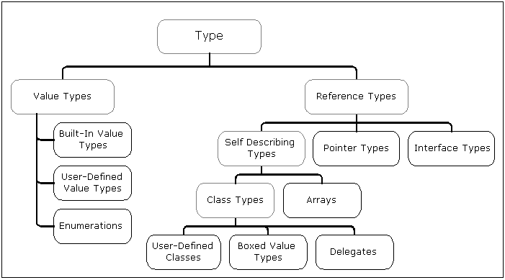
Common Type System Architecture

Slide 17
Value Types vs. Reference Types
Value Types Are Primitive or User-Defined Structures
Allocated on stack
Assigned as copies
Default behavior is pass by value
Reference Types Are Objects That Are:
Allocated on heap using the new keyword
Assigned as references
Passed by reference

Slide 18
Boxing
Boxing Occurs to Convert a Value Type to a Reference Type
Instance of System.Object is allocated on heap
Value type is copied to new object
int x = 5; //Value type
Object o = x; //Boxed
Console.WriteLine("The answer is : {0} ", x);//Boxed
Unboxing Occurs to Retrieve Value Type from Object
int y = (int) o; //unbox
Boxing Can Be Expensive If Inside Loops

Slide 19
Expressions and Operators in Visual C#
Example expressions:
+ operator
/ operator
+ and – operators
+ operator (string concatenation)
a + 1
5 / 2
a + b - 2
"ApplicationName: " + appName.ToString()

Slide 20
Declaring and Assigning Variables
Declaring variables:
Assigning variables:
Implicitly typed variables:
Instantiating object variables by using the new operator
int price;
// OR
int price, tax;
price = 10;
// OR
int price = 10;
var price = 20;
ServiceConfiguration config = new ServiceConfiguration();

Slide 21
Accessing Type Members
Invoke instance members
Example:
<instanceName>.<memberName>
var config = new ServiceConfiguration();
// Invoke the LoadConfiguration method.
config.LoadConfiguration();
// Get the value from the ApplicationName property.
var applicationName = config.ApplicationName;
// Set the .DatabaseServerName property.
config.DatabaseServerName = "78.45.81.23";
// Invoke the SaveConfiguration method.
config.SaveConfiguration();

Slide 22
Casting Between Data Types
Implicit conversion:
Explicit conversion:
as operator conversion:
System.Convert conversion:
int a = 4;
long b = 5;
b = a;
int a = (int) b;
int a = b as int;
if (a != null)
{
// Cast successful.
}
string possibleInt = "1234";
int count = Convert.ToInt32(possibleInt);

Slide 23
Manipulating Strings
Concatenating strings
Validating strings
StringBuilder address = new StringBuilder();
address.Append("23");
address.Append(", Main Street");
address.Append(", Buffalo");
string concatenatedAddress = address.ToString();
var textToTest = "hell0 w0rld";
var regularExpression = "\\d";
var result = Regex.IsMatch(textToTest, regularExpression, RegexOptions.None);
if (result)
{
// Text matched expression.
}

Slide 24
Implementing Conditional Logic
if statements
select statements
if (response == "connection_failed ") { }
else if (response == " connection_error ") { }
else { }
switch (response)
{
case "connection_failed":
break;
case "connection_success":
break;
case "connection_error":
break;
default:
break;
}

Slide 25
Implementing Iteration Logic
for loop
foreach loop
while loop
do loop
for (int i = 0 ; i < 10; i++) { ... }
string[] names = new string[10];
foreach (string name in names) { ... }
bool dataToEnter = CheckIfUserWantsToEnterData();
while (dataToEnter)
{
...
dataToEnter = CheckIfUserHasMoreData();
}
do
{
...
moreDataToEnter = CheckIfUserHasMoreData();
} while (moreDataToEnter);

Slide 26
Creating and Using Arrays
C# supports:
Single-dimensional arrays
Multidimensional
Jagged
Creating an array:
Accessing data in an array:
By index
In a loop
int[] arrayName = new int[10];
int result = arrayName[2];
for (int i = 0; i < arrayName.Length; i++)
{
int result = arrayName[i];
}

Slide 27
DataTypes → Structs
Similar to classes, but
User-defined value type
Always inherits from object
Ideal for lightweight objects
int, float, double, etc., are all structs
User-defined “primitive” types
Complex, point, rectangle, color, rational
Multiple interface inheritance
Same members as class
Member access
public, internal, private
Instantiated with new operator
Examples:
Point, Complex
Internally int, float, double, etc. are all implemented as structs
Notes:
To provide a really high performance object type, C# provides structs, which are stack allocated. They’re ideal for small objects and are really fast since they don’t depend on dynamic memory allocation and the garbage collector. It is also important to notice that it is not possible to inherit from an struct.
No protected access because there is no inheritance.

Slide 28
Referencing Namespaces
Use namespaces to organize classes into a logically related hierarchy
.NET Class Library includes:
System.Windows
System.IO
System.Data
System.Web
Define your own namespaces:
namespace FourthCoffee.Console
{
class Program
{
...
}
}

Slide 29
What Is a Method?
Methods encapsulate operations that protect data
.NET Framework applications contain a Main entry point method
The .NET Framework provides many methods in the base class library

Slide 30
Creating Methods
Methods comprise two elements:
Method specification (return type, name, parameters)
Method body
Use the ref keyword to pass parameter references
void StartService(int upTime, bool shutdownAutomatically)
{
// Perform some processing here.
}

Slide 31
Invoking Methods
To call a method specify:
Method name
Any arguments to satisfy parameters
var upTime = 2000;
var shutdownAutomatically = true;
StartService(upTime, shutdownAutomatically);
// StartService method.
void StartService(int upTime, bool shutdownAutomatically)
{
// Perform some processing here.
}

Slide 32
Creating Overloaded Methods
Overloaded methods share the same method name
Overloaded methods have a unique signature
void StopService()
{
...
}
void StopService(string serviceName)
{
...
}
void StopService(int serviceId)
{
...
}

Slide 33
Creating Methods that Use Optional Parameters
Define all mandatory parameters first
Satisfy parameters in sequence
void StopService(
bool forceStop,
string serviceName = null,
int serviceId =1)
{
...
}
var forceStop = true;
StopService(forceStop);
// OR
var forceStop = true;
var serviceName = "FourthCoffee.SalesService";
StopService(forceStop, serviceName);

Slide 34
Calling a Method by Using Named Arguments
Specify parameters by name
Supply arguments in a sequence that differs from the method’s signature
Supply the parameter name and corresponding value separated by a colon
StopService(true, serviceName: "FourthCoffee.SalesService");

Slide 35
Creating Methods that Use Output Parameters
Use the out keyword to define an output parameter
Provide a variable for the corresponding argument when you call the method
bool IsServiceOnline(string serviceName, out string statusMessage)
{
...
}
var statusMessage = string.Empty;
var isServiceOnline = IsServiceOnline(
"FourthCoffee.SalesService",
out statusMessage);

Slide 36
Interfaces
An Interface Is a Contractual Description of Methods and Properties
An Interface Has No Implementation
Use Casting in Client Code to Use an Interface
interface ICDPlayer
{
void Play(short playTrackNum);
void Pause();
void Skip(short numTracks);
short CurrentTrack
{
get;
set;
}
}

Slide 37
Handling Exceptions
What Is an Exception? Handling Exception by Using a Try/Catch Block Using a Finally Block Throwing Exceptions

Slide 38
What Is an Exception?
An exception is an indication of an error or exceptional condition
The .NET Framework provides many exception classes:
Exception
SystemException
ApplicationException
NullReferenceException
FileNotFoundException
SerializationException

Slide 39
Handling Exception by Using a Try/Catch Block
Use try/catch blocks to handle exceptions
Use one or more catch blocks to catch different types of exceptions
try
{
}
catch (NullReferenceException ex)
{
// Catch all NullReferenceException exceptions.
}
catch (Exception ex)
{
// Catch all other exceptions.
}

Slide 40
Using a Finally Block
Use a finally block to run code whether or not an exception has occurred
try
{
}
catch (NullReferenceException ex)
{
// Catch all NullReferenceException exceptions.
}
catch (Exception ex)
{
// Catch all other exceptions.
}
finally
{
// Code that always runs.
}

Slide 41
Throwing Exceptions
Use the throw keyword to throw a new exception
Use the throw keyword to rethrow an existing exception
var ex =
new NullReferenceException("The 'Name' parameter is null.");
throw ex;
try
{
}
catch (NullReferenceException ex)
{
}
catch (Exception ex)
{
...
throw;
}

Slide 42
Creating and Using Static Fields
Instance fields contain data pertinent to a specific instance of a type
Static fields contain data pertinent to the type itself
class Sales
{
public static double salesTaxPercentage = 20;
}
To access a static field, you use the name of the class, followed by a period, followed by the name of the field
Sales.salesTaxPercentage = 32;

Slide 43
DataTypes → Delegates
A delegate is a reference type that defines a method signature
When instantiated, a delegate holds one or more methods
Essentially an object-oriented function pointer
Foundation for framework events

Slide 44
Defining a Delegate
Define a delegate by using the delegate keyword
public delegate bool isValidDelegate();
Create an instance of the delegate
public isValidDelegate isValid = null;
Add method references to the delegate by using the += operator
isValid += CheckStateValid;
isValid += new isValidDelegate(CheckControl);
Remove method references from the delegate by using the -= operator
isValid -= CheckStateValid;

Slide 45
Invoking a Delegate
Always check a delegate is not null before invoking it!
Invoke a delegate synchronously by using method-like syntax
if (isValid != null)
{
isValid();
}
Invoke a delegate asynchronously by using the BeginInvoke and EndInvoke methods
if (isValid != null)
{
isValid.BeginInvoke();
}

Slide 46
What Is an Event?
An event provides a mechanism for informing consuming applications of a change of state or other occurrence in a type
Events are based on delegates
Unlike an instance of a delegate, an event can be raised (invoked) only by the containing class or a derivative of it
Consuming classes can subscribe to the event, adding references to methods that need to run when an event is raised
Events are used extensively in the .NET Framework; nearly all Windows Presentation Foundation (WPF) controls use them

Slide 47



Defining an Event
Define a delegate on which the event is based; the delegate should be at least as visible as the event
public delegate void MyEventDelegate(object sender, EventArgs e);
public event MyEventDelegate MyEvent = null;
Use the event keyword
Specify the delegate type
Specify a name for the event
You can define an event in an interface

Slide 48
Statements → using Statement
C# uses automatic memory management (garbage collection)
Eliminates most memory management problems for managed code.
For unmanaged code we must explicitly do the memory de allocation.
This is done by invoking the Dispose() method.
These objects that need to be cleaned up after usage should implement the System. IDisposable interface and the method: Dispose()
The using statement allows you to create an instance, use it, and then ensure that Dispose is called when the operation is completed.

Slide 49
Statements → using Statement
public class MyResource : IDisposable {
public void MyResource() {
// Acquire valuble resource
}
public void Dispose() {
// Release valuble resource
}
public void DoSomething() {
...
}
}
using (MyResource r = new MyResource()) {
r.DoSomething();
} // r.Dispose() is called

Slide 50
Useful links
http://msdn.microsoft.com/en-us/library/618ayhy6.aspx
http://msdn.microsoft.com/en-us/library/67ef8sbd.aspx
http://msdn.microsoft.com/en-us/library/aa288436%28v=vs.71%29.aspx
http://msdn.microsoft.com/en-us/library/dd460654.aspx
http://www.codeproject.com/Articles/219869/Object-Oriented-Programming-in-Csharp-NET

